Slide 1
SECURE DATA HIDING IN IMAGES USING STEGANOGRAPHY
CAPSTONE PROJECT
Presented By:
Student Name : GUNDA SRUJAN KUMAR
College Name & Department : Geethanjali College of Engineering & Technology ( Information Technology )

Slide 2
OUTLINE
Problem Statement
Technology used
Wow factor
End users
Result
Conclusion
Git-hub Link
Future scope

Slide 3
Problem Statement
With the increasing need for secure communication and data protection, traditional encryption methods are often vulnerable to interception and attacks. This project aims to develop a **Secure Data Hiding in Images Using Steganography** system that enables users to conceal confidential information within images, ensuring secure transmission and protection from unauthorized access. The goal is to provide an efficient, user-friendly, and robust method for embedding and retrieving hidden messages while maintaining image integrity.

Slide 4
Technology used
LIBRARIES :
Frontend
HTML: HTML5, CSS3, JavaScript – Used for structuring and designing the web interface, ensuring a user-friendly and responsive layout.
Bootstrap (Optional) – Can be used for modern styling and responsive design to enhance user experience.
Backend
Python: High-level programming language used for server-side logic.
Flask: Lightweight WSGI web application framework for Python, used to build the backend server.
OpenCV (Open Source Computer Vision Library) – Used for image processing, allowing message embedding and extraction.
NumPy – Helps with numerical computations and efficient handling of image pixel values.
PLATFORMS :
VS CODE
GITHUB

Slide 5
Wow factors
Unique features What makes this project stand out from other projects are its unique features and robust technology stack:
Secure Data Hiding with Steganography: This project ensures secure communication by embedding secret messages within images, making it undetectable to the human eye. It adds an extra layer of security using passcode-based encryption
User-Friendly & Responsive Interface: The application features a clean, modern UI with intuitive navigation, allowing users to easily encrypt and decrypt messages within images
Fast & Efficient Processing: Utilizing OpenCV and NumPy for optimized image processing, the encryption and decryption process is swift, ensuring minimal delay while maintaining high accuracy and security.
Cross-Platform Compatibility: The application supports multiple image formats (PNG, JPG, BMP, TIFF) and runs seamlessly on different operating systems and devices, ensuring accessibility for a wide range of users.

Slide 6
End users
Media and Journalism: Journalists needing to protect sensitive information.
Corporate and Business: Corporate employees sharing confidential business data.
Government and Law Enforcement: Government officials handling classified information.
Healthcare: Healthcare professionals safeguarding patient records.
Legal: Legal professionals protecting client confidentiality.
Education: Researchers and academics working with sensitive information.
Financial Institutions: Financial institutions accessing secure communications.
Non-Profit Organizations: Non-profit organizations protecting donor information.
IT and Cybersecurity: IT administrators ensuring data security within an organization.
Individuals: Individuals wanting to secure personal messages or data.

Slide 7
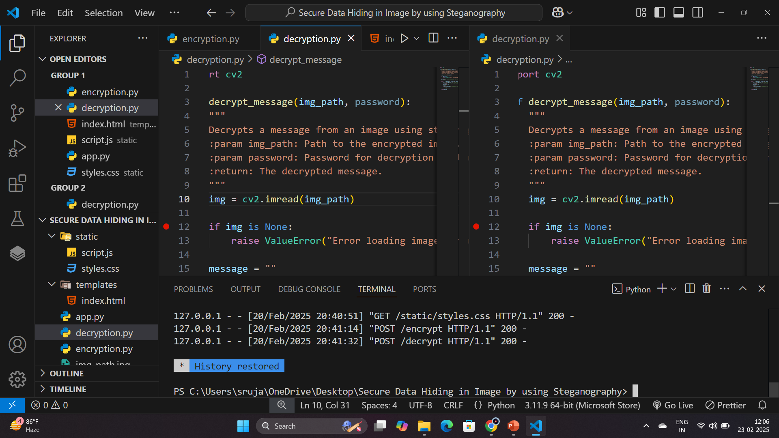
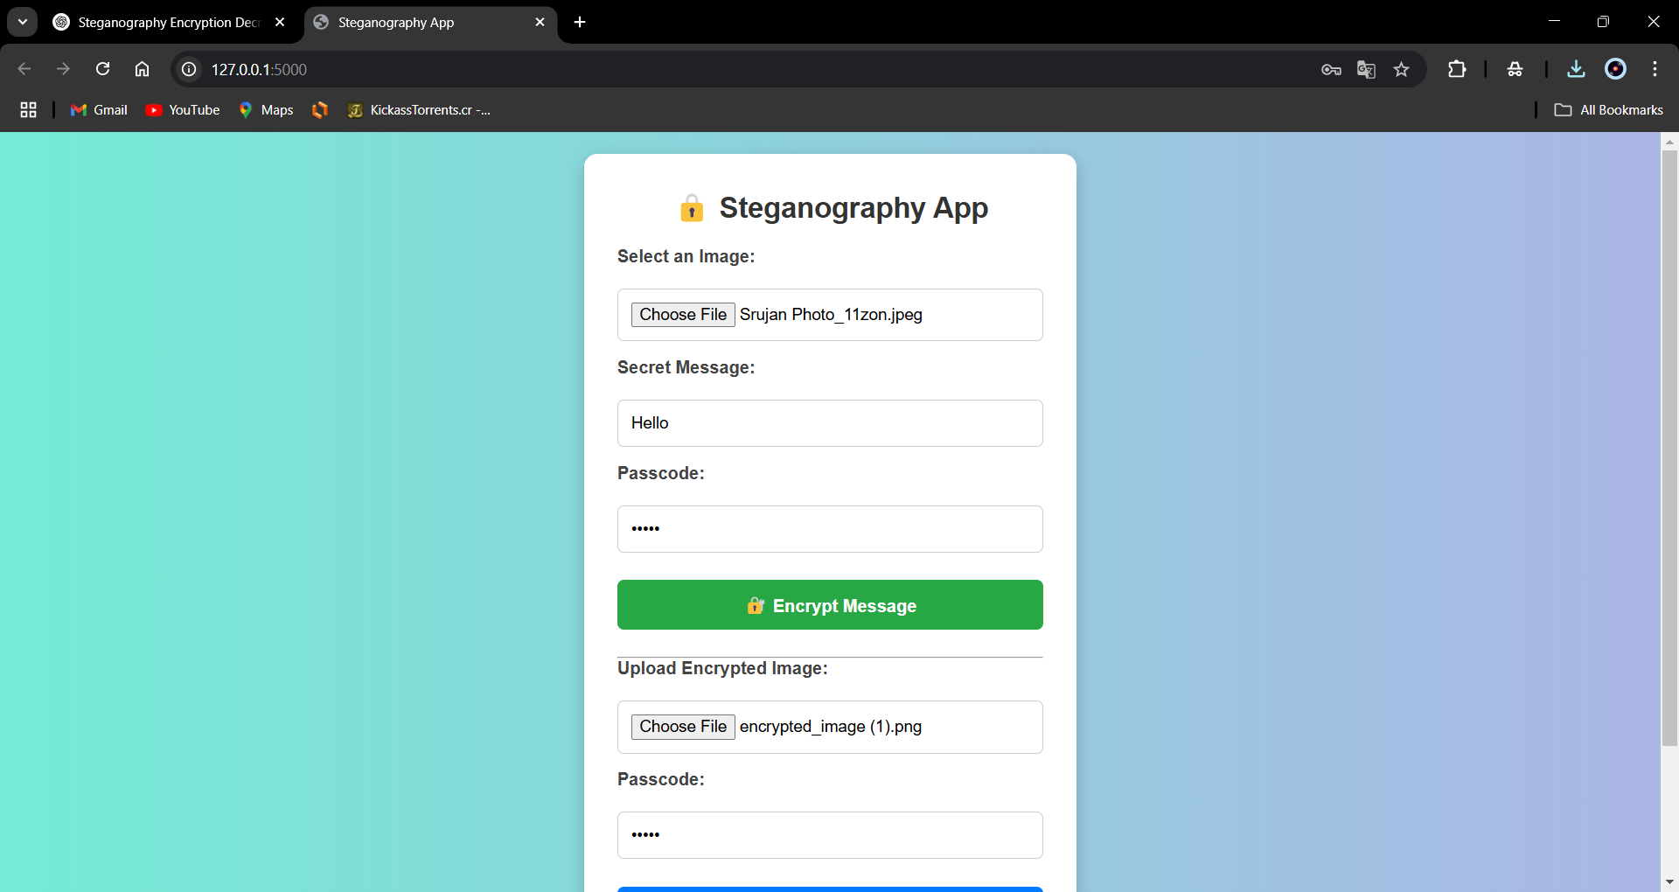
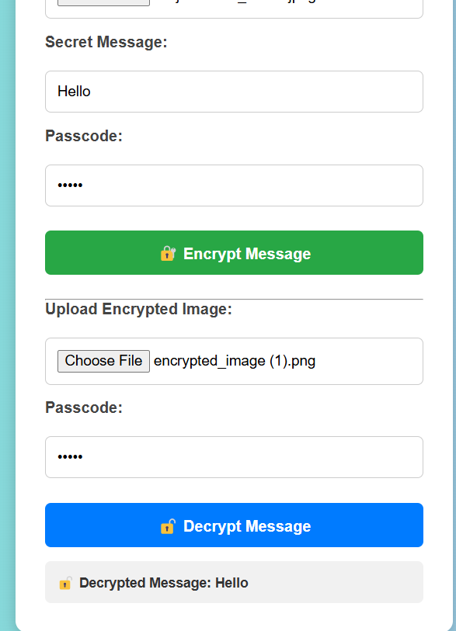
Results
CODE
OUTPUT

Slide 8
Conclusion
The Steganography App successfully demonstrates the concept of hiding secret messages within images using advanced encryption techniques. By integrating Flask for the backend and a responsive frontend, the project ensures a user-friendly and secure way to encode and decode hidden data. This application is valuable for individuals and organizations seeking discreet and safe communication. With its enhanced security, easy usability, and real-world applications, this project showcases the power of steganography in modern digital security.

Slide 9
GitHub Link
GitHub Repository URL: https://github.com/srujankumar656/SECURE-DATA-HIDING-IN-IMAGES-USING-STEGANOGRAPHY-.git

Slide 10
Future scope
✅ Implement multi-language support.
✅ Add advanced encryption algorithms for enhanced security.
✅ Develop a mobile application for on-the-go encryption and decryption.
✅ Integrate cloud storage options for secure data backup and retrieval.
✅ Enhance user interface for a more intuitive and seamless experience.
✅ Implement real-time collaboration features for team-based encryption and decryption tasks.
✅ Add support for various image formats to increase compatibility and flexibility.
✅ Develop a browser extension for quick and easy access to encryption and decryption tools.

Slide 11
THANK YOU

